Slide 1

Mindreading & Joint Action
Mindreading & Joint Action
3. Tracking, Measuring and
Representing Beliefs
butterfillS@ceu.hu
butterfillS@ceu.hu
Notes:
Last week I explained the overall project. This week I want to dive straight into a specific topic. I’ll link it back to the overall project at the end.

Slide 2
1. There are subjects who can pass A-tasks but cannot pass B-tasks.
2. These subjects’ success on A-tasks is explained by the fact that they can represent (false) beliefs
3. These subjects’ failure on B-tasks is explained by the fact that they cannot represent (false) beliefs
Notes:
Recall this puzzle from Lecture 1

Slide 3
1. There are subjects who can pass A-tasks but cannot pass B-tasks.
2. These subjects’ success on A-tasks is explained by the fact that they can represent (false) beliefs
3. These subjects’ failure on B-tasks is explained by the fact that they cannot represent (false) beliefs
Notes:
In the last lecture I we asked what might be involved in representing beliefs.
I suggested that when someone represents a belief, there are two parameters to specify.

Slide 4
1. There are subjects who can pass A-tasks but cannot pass B-tasks.
2. These subjects’ success on A-tasks is explained by the fact that they can represent (false) beliefs
3. These subjects’ failure on B-tasks is explained by the fact that they cannot represent (false) beliefs
Ayesha
Steve
Henry
...
believes
desires
intends
...
Ayesha will cycle up Hármashatár hill
s/he will cycle up Hármashatár hill
Henry will win the lottery
...
that
Subject
Attitude
Content
Notes:
In representing a belief you have to represent a subject, an attitude and a content.

Slide 5
1. There are subjects who can pass A-tasks but cannot pass B-tasks.
2. These subjects’ success on A-tasks is explained by the fact that they can represent (false) beliefs
3. These subjects’ failure on B-tasks is explained by the fact that they cannot represent (false) beliefs
Ayesha
Steve
Henry
...
believes
desires
intends
...
Ayesha will cycle up Hármashatár hill
s/he will cycle up Hármashatár hill
Henry will win the lottery
...
that
Subject
Attitude
Content
Notes:
First, you have to specify what sort of abstract objects they are using to distinguish among the contents of beliefs.
This is analogous to specifying what sort of scale someone is using when they represent the temperatures of things.

Slide 6
1. There are subjects who can pass A-tasks but cannot pass B-tasks.
2. These subjects’ success on A-tasks is explained by the fact that they can represent (false) beliefs
3. These subjects’ failure on B-tasks is explained by the fact that they cannot represent (false) beliefs
Ayesha
Steve
Henry
...
believes
desires
intends
...
Ayesha will cycle up Hármashatár hill
s/he will cycle up Hármashatár hill
Henry will win the lottery
...
that
Subject
Attitude
Content
Notes:
Second, you have to specify what sort of model they are using of the attitudes.
This is analogous to specifying what sort of model someone is using when they represent mass or force---they might be thinking about these things in terms of the roles they have classical or quantum theories for example, or in some other way.
Last week I tried to suggest there are simpler and more complex models of the attitudes.
I wanted us to focus on decision theory as a model of belief and desire and how they might interact to produce actions because this is such a well-studied model, and one that seems to be realised by a wide range of structures from large organizations to parts of human motor control.
I didn’t mean to suggest that there are stronger reasons for being interested in decision theory, however.

Slide 7
Infants’ false-belief tracking abilities
Violation of expectations - with change of location - with deceptive contents
- observing verbal comm^{n}
Anticipating action - looking
- pointing
Helping
Communicating
Altercentric interference
(Onishi & Baillargeon 2005) (He et al 2011) (Song et al 2008; Scott et al 2012)
(Southgate et al 2007)
(Clements et al 1994) (Knudsen & Liszkowski 2011)
A-tasks
(Buttlemann et al 2009)
(Southgate et al 2010)
(Kovacs et al 2010)
Notes:
Call these A-tasks. Two conjectures. First, there is a single competence which these tasks measure. Second, this competence is an ability to represent belief.

Slide 8
Infants’ false-belief tracking abilities
Violation of expectations - with change of location - with deceptive contents
- observing verbal comm^{n}
Anticipating action - looking
- pointing
Helping
Communicating
Altercentric interference
(Onishi & Baillargeon 2005) (He et al 2011) (Song et al 2008; Scott et al 2012)
(Southgate et al 2007)
(Clements et al 1994) (Knudsen & Liszkowski 2011)
A-tasks
(Buttlemann et al 2009)
(Southgate et al 2010)
(Kovacs et al 2010)
Notes:
Call these A-tasks. Two conjectures. First, there is a single competence which these tasks measure. Second, this competence is an ability to represent belief.

Slide 9
What could someone represent that would enable her to track, at least within limits, others' perceptions, knowledge states and beliefs including false beliefs?

Slide 10
What could someone represent that would enable her to track, at least within limits, others' perceptions, knowledge states and beliefs including false beliefs?

Slide 11
X preens me
X sings
X likes me
preen X

Slide 12
X preens me
X sings
X likes me
preen X

Slide 13
X preens me
X sings
X likes me
preen X

Slide 14
What could someone represent that would enable her to track, at least within limits, others' perceptions, knowledge states and beliefs including false beliefs?

Slide 15
*** do the preening thing? (to help explain tracking?)

Slide 16
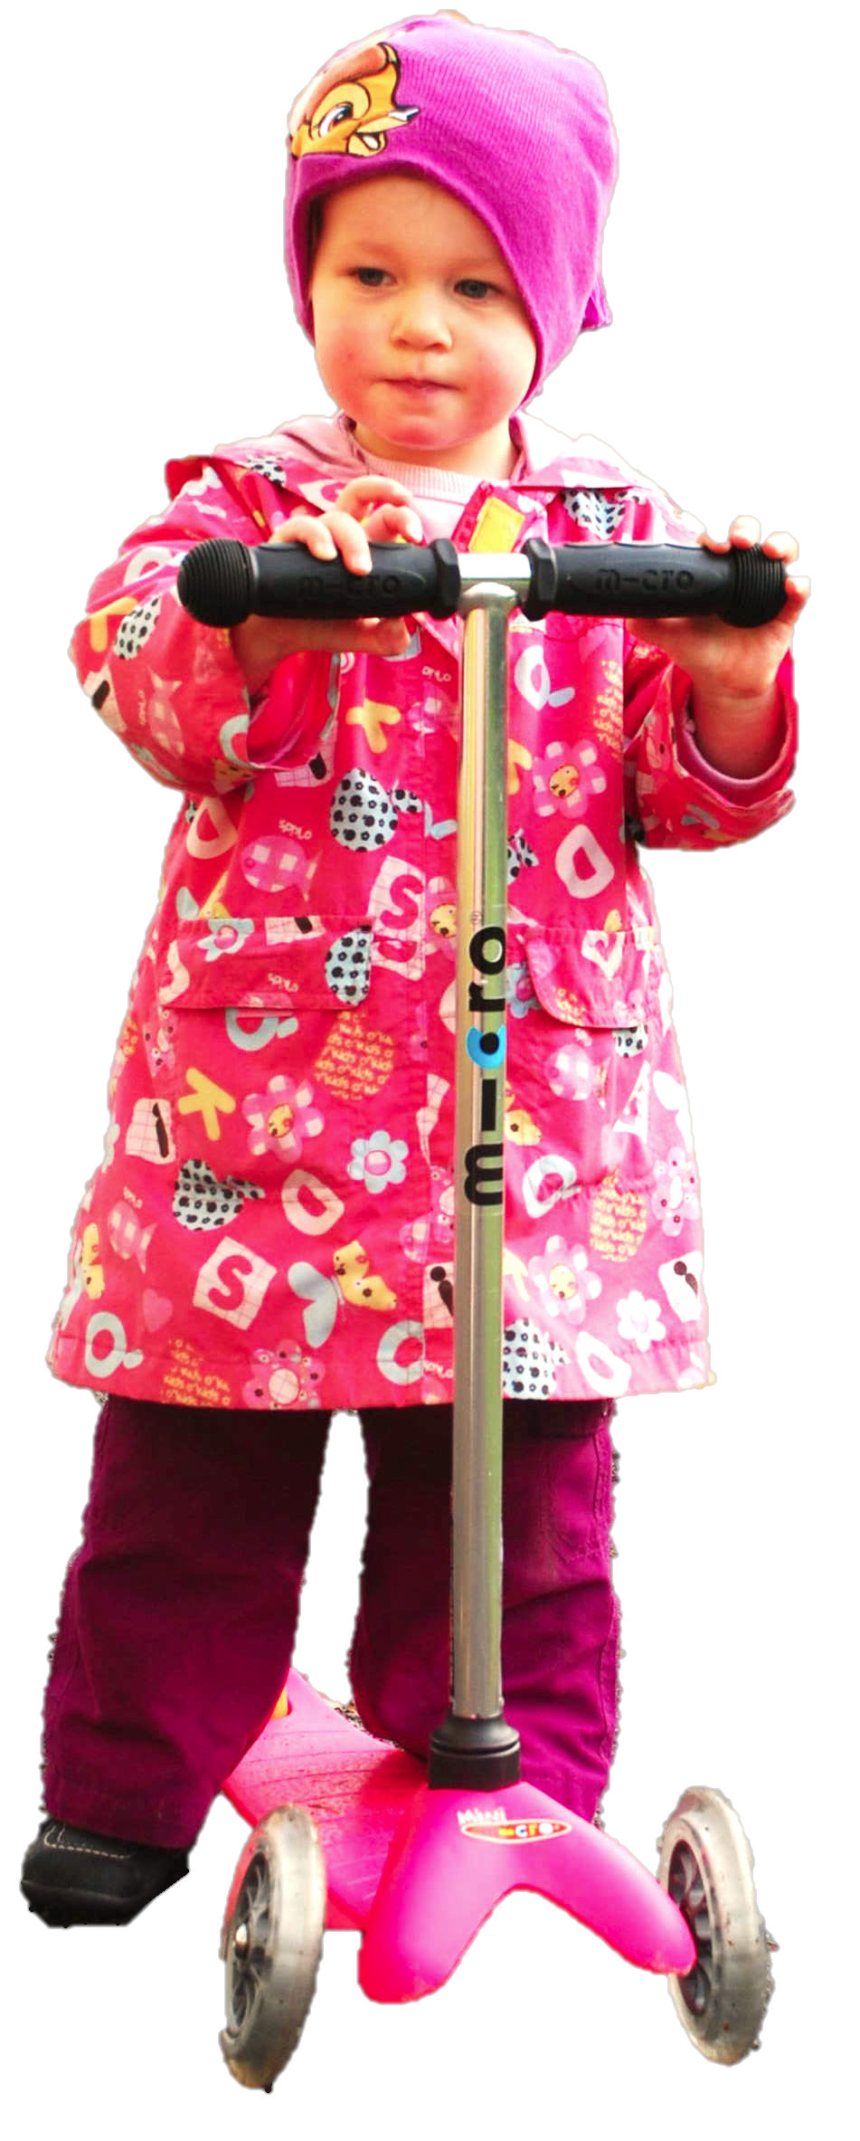
What could someone represent that would enable her to track, at least within limits, others' perceptions, knowledge states and beliefs including false beliefs?

Slide 17
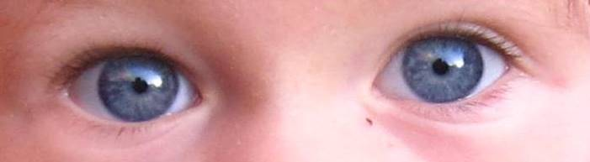
What could someone represent that would enable her to track, at least within limits, others' perceptions, knowledge states and beliefs including false beliefs?

Slide 18
A puzzle
Notes:
Last week I explained the overall project. This week I want to dive straight into a specific topic. I’ll link it back to the overall project at the end.

Slide 19
Infants’ false-belief tracking abilities
(Southgate et al 2007)
Notes:
this was last week (we considered these experiments in detail)

Slide 20
Infants’ false-belief tracking abilities
Violation of expectations - with change of location - with deceptive contents
- observing verbal comm^{n}
Anticipating action - looking
- pointing
(Onishi & Baillargeon 2005) (He et al 2011) (Song et al 2008; Scott et al 2012)
(Southgate et al 2007)
(Clements et al 1994) (Knudsen & Liszkowski 2011)
Notes:
this was last week (we considered these experiments in detail)

Slide 21
Infants’ false-belief tracking abilities
Violation of expectations - with change of location - with deceptive contents
- observing verbal comm^{n}
Anticipating action - looking
- pointing
Helping
Communicating
Altercentric interference
(Onishi & Baillargeon 2005) (He et al 2011) (Song et al 2008; Scott et al 2012)
(Southgate et al 2007)
(Clements et al 1994) (Knudsen & Liszkowski 2011)
(Buttlemann et al 2009)
(Southgate et al 2010)
(Kovacs et al 2010)
Notes:
... but there are a lot more experiments we might consider

Slide 22
Infants’ false-belief tracking abilities
Violation of expectations - with change of location - with deceptive contents
- observing verbal comm^{n}
Anticipating action - looking
- pointing
Helping
Communicating
Altercentric interference
(Onishi & Baillargeon 2005) (He et al 2011) (Song et al 2008; Scott et al 2012)
(Southgate et al 2007)
(Clements et al 1994) (Knudsen & Liszkowski 2011)
A-tasks
(Buttlemann et al 2009)
(Southgate et al 2010)
(Kovacs et al 2010)
Notes:
Call these A-tasks. Two conjectures. First, there is a single competence which these tasks measure. Second, this competence is an ability to represent belief.

Slide 23
1. There are subjects who can pass A-tasks
2. These subjects’ success on A-tasks is explained by the fact that they can represent (false) beliefs

Slide 24
3-year-olds fail false belief tasks
prediction
- action
- desire
retrodiction or explanation
select a suitable argument
own beliefs (first person)
involvement (deception)
nonverbal response
test questions word-for-word identical to desire and pretence tasks
(Wimmer & Perner 1983) (Astington & Gopnik 1991) (Wimmer & Mayringer 1998) (Bartsch & London 2000)
(Gopnik & Slaughter 1991)
(Chandler et al 1989)
(Call et al 1999; Low 2010 exp.2)
(Gopnik et al 1994; Cluster 1996)
Notes:
3-year-olds fail a wide variety of tasks where they are asked about a false belief, or asked to predict how someone with a false belief will act, or asked to predict what someone with a false belief will desire, or to retrodict a false belief after being shown how someone acts. Further, lots of factors make no difference to 3-year-olds’ performance: they fail tasks about other’s beliefs and they fail tasks about their own beliefs; they fail when they are merely observers as well as when they are actively involved; they fail when a verbal response is required and also when an nonverbal communicative response or even a noncommunicative response (such as hiding an object) is required.

Slide 25
3-year-olds fail false belief tasks
prediction
- action
- desire
retrodiction or explanation
select a suitable argument
own beliefs (first person)
involvement (deception)
nonverbal response
test questions word-for-word identical to desire and pretence tasks
(Wimmer & Perner 1983) (Astington & Gopnik 1991) (Wimmer & Mayringer 1998) (Bartsch & London 2000)
(Gopnik & Slaughter 1991)
(Chandler et al 1989)
(Call et al 1999; Low 2010 exp.2)
(Gopnik et al 1994; Cluster 1996)
Notes:
3-year-olds fail a wide variety of tasks where they are asked about a false belief, or asked to predict how someone with a false belief will act, or asked to predict what someone with a false belief will desire, or to retrodict a false belief after being shown how someone acts. Further, lots of factors make no difference to 3-year-olds’ performance: they fail tasks about other’s beliefs and they fail tasks about their own beliefs; they fail when they are merely observers as well as when they are actively involved; they fail when a verbal response is required and also when an nonverbal communicative response or even a noncommunicative response (such as hiding an object) is required.

Slide 26
3-year-olds fail false belief tasks
prediction
- action
- desire
retrodiction or explanation
select a suitable argument
own beliefs (first person)
involvement (deception)
nonverbal response
test questions word-for-word identical to desire and pretence tasks
(Wimmer & Perner 1983) (Astington & Gopnik 1991) (Wimmer & Mayringer 1998) (Bartsch & London 2000)
(Gopnik & Slaughter 1991)
(Chandler et al 1989)
(Call et al 1999; Low 2010 exp.2)
(Gopnik et al 1994; Cluster 1996)
Notes:
3-year-olds fail a wide variety of tasks where they are asked about a false belief, or asked to predict how someone with a false belief will act, or asked to predict what someone with a false belief will desire, or to retrodict a false belief after being shown how someone acts. Further, lots of factors make no difference to 3-year-olds’ performance: they fail tasks about other’s beliefs and they fail tasks about their own beliefs; they fail when they are merely observers as well as when they are actively involved; they fail when a verbal response is required and also when an nonverbal communicative response or even a noncommunicative response (such as hiding an object) is required.

Slide 27
3-year-olds fail false belief tasks
prediction
- action
- desire
retrodiction or explanation
select a suitable argument
own beliefs (first person)
involvement (deception)
nonverbal response
test questions word-for-word identical to desire and pretence tasks
(Wimmer & Perner 1983) (Astington & Gopnik 1991) (Wimmer & Mayringer 1998) (Bartsch & London 2000)
(Gopnik & Slaughter 1991)
(Chandler et al 1989)
(Call et al 1999; Low 2010 exp.2)
(Gopnik et al 1994; Cluster 1996)
Notes:
3-year-olds fail a wide variety of tasks where they are asked about a false belief, or asked to predict how someone with a false belief will act, or asked to predict what someone with a false belief will desire, or to retrodict a false belief after being shown how someone acts. Further, lots of factors make no difference to 3-year-olds’ performance: they fail tasks about other’s beliefs and they fail tasks about their own beliefs; they fail when they are merely observers as well as when they are actively involved; they fail when a verbal response is required and also when an nonverbal communicative response or even a noncommunicative response (such as hiding an object) is required.

Slide 28
3-year-olds fail false belief tasks
prediction
- action
- desire
retrodiction or explanation
select a suitable argument
own beliefs (first person)
involvement (deception)
nonverbal response
test questions word-for-word identical to desire and pretence tasks
(Wimmer & Perner 1983) (Astington & Gopnik 1991) (Wimmer & Mayringer 1998) (Bartsch & London 2000)
(Gopnik & Slaughter 1991)
B-tasks
(Chandler et al 1989)
(Call et al 1999; Low 2010 exp.2)
(Gopnik et al 1994; Cluster 1996)
Notes:
Despite all this variation and more, the B-tasks all appear to measure a single developmental transition for success on them is highly correlated (Wellman et al. 2001).
The natural explanation for subjects’ failure is that they cannot represent beliefs.

Slide 29
1. There are subjects who can pass A-tasks but cannot pass B-tasks.
2. These subjects’ success on A-tasks is explained by the fact that they can represent (false) beliefs
3. These subjects’ failure on B-tasks is explained by the fact that they cannot represent (false) beliefs

Slide 30
1. There are subjects who can pass A-tasks but cannot pass B-tasks.
2. These subjects’ success on A-tasks is explained by the fact that they can represent (false) beliefs
3. These subjects’ failure on B-tasks is explained by the fact that they cannot represent (false) beliefs
Notes:
Putting the two claims together gives us a contradiction. which claim should we reject?

Slide 31
1. There are subjects who can pass A-tasks but cannot pass B-tasks.
2. These subjects’ success on A-tasks is explained by the fact that they can represent (false) beliefs
3. These subjects’ failure on B-tasks is explained by the fact that they cannot represent (false) beliefs
Notes:
It’s a conspiracy by scientists to confuse philosophers.

Slide 32
1. There are subjects who can pass A-tasks but cannot pass B-tasks.
2. These subjects’ success on A-tasks is explained by the fact that they can represent (false) beliefs
3. These subjects’ failure on B-tasks is explained by the fact that they cannot represent (false) beliefs
Notes:
Maybe we should reject this premise?

Slide 33
Infants’ false-belief tracking abilities
Violation of expectations - with change of location - with deceptive contents
- observing verbal comm^{n}
Anticipating action - looking
- pointing
Helping
Communicating
Altercentric interference
(Onishi & Baillargeon 2005) (He et al 2011) (Song et al 2008; Scott et al 2012)
(Southgate et al 2007)
(Clements et al 1994) (Knudsen & Liszkowski 2011)
A-tasks
(Buttlemann et al 2009)
(Southgate et al 2010)
(Kovacs et al 2010)
Notes:
variety in both measures and types of task makes hard to question on methodological grounds.
People did initially try to suggest that infants were merely representing patterns of behaviour. Given that we don’t know much about infants’ actual behaviour reading capacities, it is hard to evaluate this hypothesis. Certainly no one has shown that infants’ are able to track the sorts of patterns of behaviour they would need to track in order to solve false belief tasks.
[while some have proposed that infants might be tracking behaviour only Perner & Ruffman (2005); Ruffman & Perner (2005), this proposal faces several objections (e.g. Song et al. 2008).]

Slide 34
1. There are subjects who can pass A-tasks but cannot pass B-tasks.
2. These subjects’ success on A-tasks is explained by the fact that they can represent (false) beliefs
3. These subjects’ failure on B-tasks is explained by the fact that they cannot represent (false) beliefs
Notes:
so we’re stuck with the second premise.

Slide 35
1. There are subjects who can pass A-tasks but cannot pass B-tasks.
2. These subjects’ success on A-tasks is explained by the fact that they can represent (false) beliefs
3. These subjects’ failure on B-tasks is explained by the fact that they cannot represent (false) beliefs
Notes:
One might attempt to reject this claim on the grounds that the B-tasks impose demands which are extraneous in the sense that they are not a consequence merely of being required to represent false beliefs
(proponents of this view include
\citealp[p.\ 417]{Carpenter:2002gc},
\citealp{Bloom:2000bt}, and
\citealp{Leslie:1998nq}).

Slide 36
1. There are subjects who can pass A-tasks but cannot pass B-tasks.
2. These subjects’ success on A-tasks is explained by the fact that they can represent (false) beliefs
3. These subjects’ failure on B-tasks is explained by the fact that they cannot represent (false) beliefs
All B-tasks impose a requirement (or set of requirements) other than the requirement to represent a false belief.
Notes:
The thesis we are considering is this: All B-tasks impose a requirement (or set of requirements) other than the requirement to represent a false belief. Children fail B-tasks not because they cannot represent beliefs but because they fail to meet the extraneous requirement.
But what could the extraneous requirement be?

Slide 37
3-year-olds fail false belief tasks
prediction
- action
- desire
retrodiction or explanation
select a suitable argument
own beliefs (first person)
involvement (deception)
nonverbal response
test questions word-for-word identical to desire and pretence tasks
(Wimmer & Perner 1983) (Astington & Gopnik 1991) (Wimmer & Mayringer 1998) (Bartsch & London 2000)
(Gopnik & Slaughter 1991)
B-tasks
(Chandler et al 1989)
(Call et al 1999; Low 2010 exp.2)
(Gopnik et al 1994; Cluster 1996)
Notes:
First note that the proposal is harder to defend than sometimes assumed. For instance, philosophers sometimes mistakenly assume that all B-tasks involve language or communication, whereas A-tasks do not. But some A-tasks involve language and communication (Knudsen & Liszkowski 2012; Song et al. 2008) and there are non-verbal B-tasks (Call & Tomasello 1999; Low 2010 Study 2).
There is a more general problem facing attempts to identify the Extraneous Requirement. there is much variation among the B-tasks. It is not just that some are verbal whereas others are nonverbal. It is also that some involve prediction whereas others involve retrodiction or justification (e.g. Wimmer & Mayringer 1998), some concern the first-person perspective, whereas others involve a second- or third-person perspective (e.g. Gopnik & Slaughter 1991), some involve interaction whereas in others the subject is a mere observer (e.g. Chandler et al. 1989), and some involve prediction actions whereas others involve predicting desires (Astington & Gopnik 1991) or selecting an argument appropriate for someone with a false belief (Bartsch & London 2000). Despite all this variation and more, the B-tasks all appear to measure a single developmental transition (Wellman et al. 2001).

Slide 38
3-year-olds fail false belief tasks
prediction
- action
- desire
retrodiction or explanation
select a suitable argument
own beliefs (first person)
involvement (deception)
nonverbal response
test questions word-for-word identical to desire and pretence tasks
(Wimmer & Perner 1983) (Astington & Gopnik 1991) (Wimmer & Mayringer 1998) (Bartsch & London 2000)
(Gopnik & Slaughter 1991)
B-tasks
(Chandler et al 1989)
(Call et al 1999; Low 2010 exp.2)
(Gopnik et al 1994; Cluster 1996)
Notes:
Further, children who fail B-tasks can answer questions about perception or pretence that are word-for-word identical with the questions about false belief that they cannot answer correctly (Gopnik et al. 1994; see also Cluster 1996). So the Extraneous Requirement cannot be straightforwardly linked to language or communication.

Slide 39
3-year-olds fail false belief tasks
prediction
- action
- desire
retrodiction or explanation
select a suitable argument
own beliefs (first person)
involvement (deception)
nonverbal response
test questions word-for-word identical to desire and pretence tasks
(Wimmer & Perner 1983) (Astington & Gopnik 1991) (Wimmer & Mayringer 1998) (Bartsch & London 2000)
(Gopnik & Slaughter 1991)
B-tasks
(Chandler et al 1989)
(Call et al 1999; Low 2010 exp.2)
(Gopnik et al 1994; Cluster 1996)
Notes:
But there is a family of candidates for the Extraneous Requirement.
For a wide range of research has shown that success on B-tasks depends on executive function, working memory and attention. This is true in two senses: first, developmentally, success on B-tasks comes with the acquisition of EF, working memory and so on. Second, even in adults success on B-tasks appears to consume these resources.
So have we found the Extraneous Requirement? No, I don’t think It is a mistake to assume that representing false belief---or, indeed, representing any propositional attitude---does not intrinsically demand cognitive resources such as inhibitory control.
On any standard view, propositional attitudes such as beliefs form complex causal structures, have arbitrarily nest-able contents, interact with each other in uncodifiably complex ways and are individuated by their causal and normative roles in explaining thoughts and actions \citep[]{en_809, en_249}.
If there is anything representing which should consume scarce cognitive resources it is surely states with this combination of properties.
So there are sound theoretical reasons to suppose that representing false beliefs could intrinsically require inhibitory control and working memory \citep[see also][]{Russell:1999vr}.
This means: it *might* be that B-tasks impose an extraneous requirement. But the mere fact that success depends on inhibitory control, attention and working memory does not imply that these B-tasks impose extraneous requirements.

Slide 40
1. There are subjects who can pass A-tasks but cannot pass B-tasks.
2. These subjects’ success on A-tasks is explained by the fact that they can represent (false) beliefs
3. These subjects’ failure on B-tasks is explained by the fact that they cannot represent (false) beliefs
All B-tasks impose a requirement (or set of requirements) other than the requirement to represent a false belief.
Notes:
What I’ve argued so far is that we cannot straightforwardly reject any single premise of this argument.
So we should look for non-straightforward ways to resolve the problem

Slide 41
1. There are subjects who can pass A-tasks but cannot pass B-tasks.
2. These subjects’ success on A-tasks is explained by the fact that they can represent (false) beliefs
3. These subjects’ failure on B-tasks is explained by the fact that they cannot represent (false) beliefs
Notes:
What could a non-straightforward resolution involve? First note that we get this kind of pattern in a variety of areas including physical cognition.

Slide 42
— Neil Berthier, De Blois, et al. (2000: 395)

Slide 43
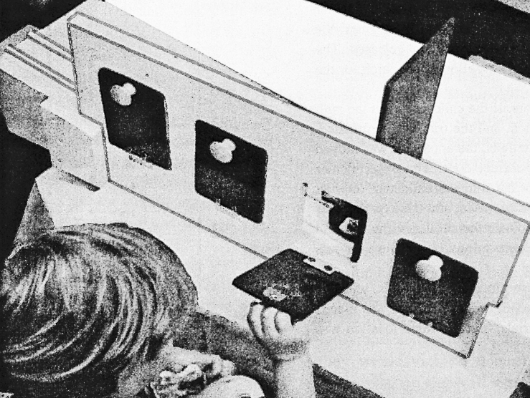
— Neil Berthier, De Blois, et al. (2000: 395)

Slide 44
— Neil Berthier, De Blois, et al. (2000: 395)

Slide 45
— Neil Berthier, De Blois, et al. (2000: 395)
Notes:
One common error pattern among older children – look behind door next to barrier but on wrong side of it

Slide 46
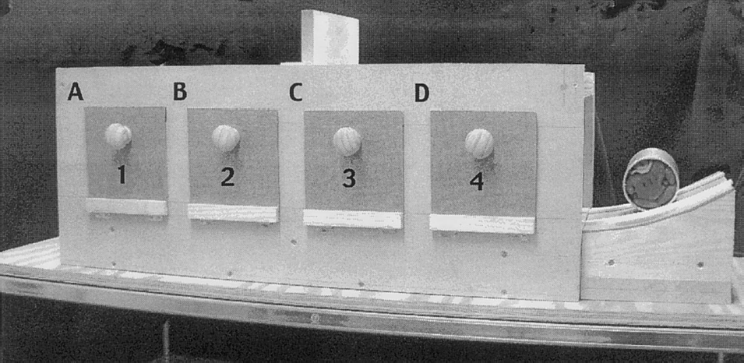
(Hood et al, 2003)
Notes:
2.5-year-olds look longer when experimenter removes the ball from behind the wrong door, but don't reach to the correct door

Slide 47
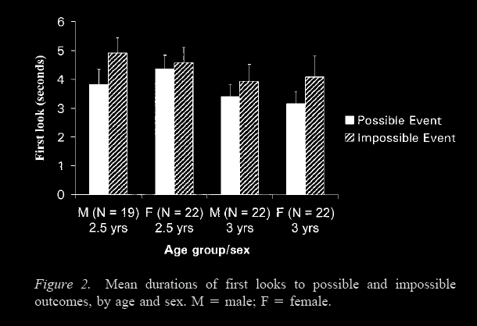
Looking time reveals causal understanding and 2.5- and 3-year olds
-- Hood et al (2003: 65)
(Hood et al, 2003)
Notes:
2.5-year-olds look longer when experimenter removes the ball from behind the wrong door, but don't reach to the correct door
Although the most studied case is false belief, this discrepancy between measures is very common. It occurs for tests involving physical reasoning, number, and speech; and probably also involving agency and space.

Slide 48
1. There are subjects who can pass A-tasks but cannot pass B-tasks.
2. These subjects’ success on A-tasks is explained by the fact that they can represent (false) beliefs
3. These subjects’ failure on B-tasks is explained by the fact that they cannot represent (false) beliefs
in a modular process
in a non-modular process
Notes:
The first step, then, is to distinguish two systems for representing beliefs, just as we have to distinguish multiple systems for representing causation, number, speech, space and the rest.
The distinction is between modular mindrreading and nonmodular mindreading.
But this distinction, although formally it removes the contradiction, raises a hard question.
How could belief ascription be modular?
On the face of it, anything you know, anything at all, can be relevant to a belief ascription. So representing and ascribing beliefs looks to be a paradigm case of the sort of thing that cannot be modular.
So we need to do more work to make this proposal plausible, to make it more than a merely formal move.

Slide 49
What is a representation of belief?
Notes:
We need to ask, what is a representation of belief?
there is no a priori reason to assume that all subjects who represent beliefs represent them with perfect accuracy

Slide 50
What is a representation of belief?
of efficiency?
Notes:
An analogy may help \citep[this is based on][]{matthews:2007_measure}.
There are various ways to represent the efficiency of your car.
If you were very exact, you might use a measure relating force to fuel consumption.
But many people will instead measure distance in relation to fuel consumption,
or even just fuel consumption in relation to periods of time (perhaps monthly).
The point is that we have different ways of representing (measuring) efficiency.
Some of these are highly flexible in the sense that they can cope with variations in landscape and even gravity but they are also more costly to implement in terms of the time and background knowledge they demand;
while others are less costly to implement but also more limited in the sense that they only work in a more limited range of circumstances (perhaps only when the car is used in roughly the same way each month).
What I am suggesting is that there is a parallel for representing (measuring) belief.
On rich conceptions of belief, accurately representing belief will enable one to make fine-grained distinctions and to track complex contents, and this will demand conceptual sophistication and impose cognitive demands.
On other, simpler conceptions of belief, accurately representing belief will yield less flexibility in distinguishing what others belief and in predicting their actions but the reduced flexibility in greater cognitive efficiency.

Slide 51
What is a representation of belief?
of efficiency?
Notes:
Whatever belief actually is,
there may be multiple ways of representing it,
just as there are multiple ways of measuring fuel efficiency.
Different ways of representing belief will vary in how flexible they are and how demanding they are to implement.
Saying that a subject can represent beliefs is like saying that she can represent fuel efficiency.
It leaves open the question of how she represents beliefs.
For instance, does she represent the contents of beliefs as simple tuples, as propositions of some kind, as images or maps, or what?
The answer may vary for different subjects.
And of course a single subject may use multiple ways of representing beliefs in different contexts (much as a single subject might rely on different ways of measuring fuel efficiency in different contexts).
It is striking that almost no research has directly addressed the issue of how beliefs are represented in infants, children or adults.

Slide 52
1. There are subjects who can pass A-tasks but cannot pass B-tasks.
2. These subjects’ success on A-tasks is explained by the fact that they can represent (false) beliefs
3. These subjects’ failure on B-tasks is explained by the fact that they cannot represent (false) beliefs
using a simple measure
in a modular process
using a sophisticated measure
in a non-modular process
Notes:
The second step, then, is to distinguish different measures of belief, different things representing which might enable you to track beliefs.

Slide 53
What could infants, chimps and scrub-jays represent that would enable them, within limits, to track others’ perceptions, knowledge, beliefs and other propositional attitudes?
question
Notes:
I have motivated asking this question.
The point is that it’s not enough to answer simply by saying ’belief’.
We need to know how they represent (measure) beliefs.

Slide 54
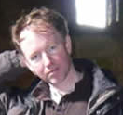
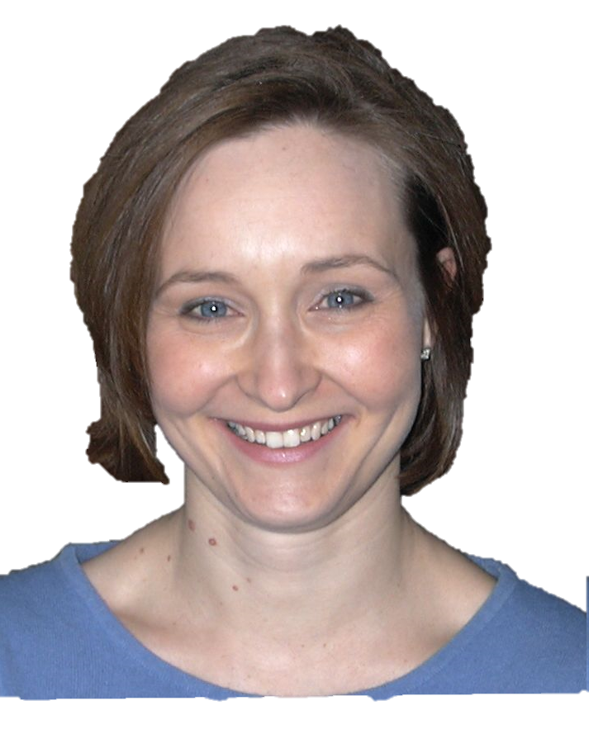


What could infants, chimps and scrub-jays represent that would enable them, within limits, to track others’ perceptions, knowledge, beliefs and other propositional attitudes?
question

Slide 55
Propositional attitude

Slide 56
Propositional attitude
Relational attitude

Slide 57
Propositional attitude
Relational attitude
e.g. believes that ... e.g. intends that ... e.g. knows that ...
e.g. excited by ... e.g. encountered ... e.g. wants apple juice
Notes:
Paradigmatic examples of relational attitudes are things like
being excited by an event,
encountering an object,
or wanting some type of thing.

Slide 58
Propositional attitude
Relational attitude
e.g. believes that ... e.g. intends that ... e.g. knows that ...
e.g. excited by ... e.g. encountered ... e.g. wants apple juice
arbitrarily nestable contents
uncodifiably complex effects on action
permit mistakes about appearance, identity and existence
no contents
parameter-setting effects on action
enable tracking a limited range of false beliefs only
Notes:
whereas propositional attitudes have arbitrarily nestable contents,
relational attitudes have no contents
whereas propositional attitudes have uncodifiably complex effects on action,
relational attitudes set parameters for action
and whereas representing relational attitudes would permit a mindreader to track false beliefs involving mistakes about
appearances,
identity
and
existence,
representing relational attitudes would allow one to track only a limited range of false beliefs about properties such as location, colour and shape.
So consider this hypothesis:
whereas non-modular mindreading involves representing propositional attitudes,
modular mindreading involves representing relational attitudes only.
This hypothesis, if true, would explain why modular mindreading is less demanding than full-blown mindreading.

Slide 59
Propositional attitude
Relational attitude
e.g. believes that ... e.g. intends that ... e.g. knows that ...
e.g. excited by ... e.g. encountered ... e.g. wants apple juice
arbitrarily nestable contents
uncodifiably complex effects on action
permit mistakes about appearance, identity and existence
no contents
parameter-setting effects on action
enable tracking a limited range of false beliefs only
Notes:
This hypothesis also has the virtue of indicating what sort of limits could distinguish modular from non-modular mindreading ...

Slide 60
Propositional attitude
Relational attitude
level-1 perspective taking
level-2 perspective taking
Y
Y
Y
N
Notes:
for the hypothesis suggests that
- modular mindreading should be good for level-1 perspective taking tasks,
but not for level-2 perspective taking tasks.
Some work on the level-1/level-2 distinction has already been published,
and this does suggest that for both children and adults,
automatic mindreading may be sufficient for success on level-1 but not level-2 perspective taking tasks.
But since this has already been published I don't want to cover that here.

Slide 61
Propositional attitude
Relational attitude
level-1 perspective taking
level-2 perspective taking
false beliefs about non-existence
Y
Y
Y
Y
N
N
Notes:
The hypothesis about relational attitudes also suggests that
- modular mindreading should be good for tracking false beliefs with a simple predicate-object structure, but not for tracking false beliefs which essentially involve the non-existence of something.

Slide 62
Propositional attitude
Relational attitude
level-1 perspective taking
level-2 perspective taking
false beliefs about non-existence
false beliefs about location
false beliefs about identity
Y
Y
Y
Y
Y
Y
N
N
Y
N
Notes:
and, finally, the hypothesis suggests that
-modular mindreading should be good for tracking false beliefs about the location of something,
but not for tracking false beliefs which essentially involve mistakes about identity.
So one nice feature of this hypothesis is that it makes several independently testable predictions about the limits of automatic mindreading.
If we want to find out whether adult automatic mindreading and infant mindreading are subject to the same limits,
it makes sense to start by looking at these limits.
I want to finish by focusing on the issue of false beliefs about location vs. false beliefs about identity.
What do we mean by a mistake about identity?
Here's an illustration.
Suppose that a single person has two roles that don't often go together,
say she is both a school teacher by day and an assassin by night.
If you shot the assassin, you might be surprised that the school teacher doesn't turn up to work.
They are one and the same person but you didn't know that.
This would be a mistake about identity: in mistakenly expecting the school teacher to turn up, you have failed to realise that she is the assassin.
Your mistake could be predicted by subjects who can represent propositional attitudes as such.
But it cannot be predicted by subjects who represent relational attitudes only.

Slide 63

Your field = a set of objects related to you by proximity, orientation, lighting and other factors
You encounter an object = it is in your field
You register an object at a location = you most recently encountered the object at that location

Slide 64
Your field = a set of objects related to you by proximity, orientation, lighting and other factors
You encounter an object = it is in your field
You register an object at a location = you most recently encountered the object at that location
proximity
orientation
lighting
barriers
trajectory
Notes:
An agent’s field is a set of objects related to the agent by proximity. The extent of the field depends on things like lighting and the agent’s orientation.

Slide 65
Your field = a set of objects related to you by proximity, orientation, lighting and other factors
You encounter an object = it is in your field
You register an object at a location = you most recently encountered the object at that location
proximity
orientation
lighting
barriers
trajectory
Notes:
To say that an agent is encountering an object just means that it is in her field. The notion of encountering is a proxy for perception: within limits, an agent perceives an object just when she encounters one. But to think about encountering doesn’t require understanding perception. In particular it doesn’t require understanding perceptual modalities, or perspectives or appearances.

Slide 66
Your field = a set of objects related to you by proximity, orientation, lighting and other factors
You encounter an object = it is in your field
You register an object at a location = you most recently encountered the object at that location
Principle 1: one can’t goal-directedly act on an object unless one has encountered it.
Principle 2: correct registration is a condition of successful action.
Principle 3: when an agent performs a goal-directed action and the goal specifies an object, the agent will act as if the object were actually in the location she registers it at.
proximity
orientation
lighting
barriers
trajectory
Notes:
The third principle says that you can only act on a goal involving an object if you have encountered it. So if you know that someone hasn’t encountered an object, you can predict that they won’t look for it.

Slide 67
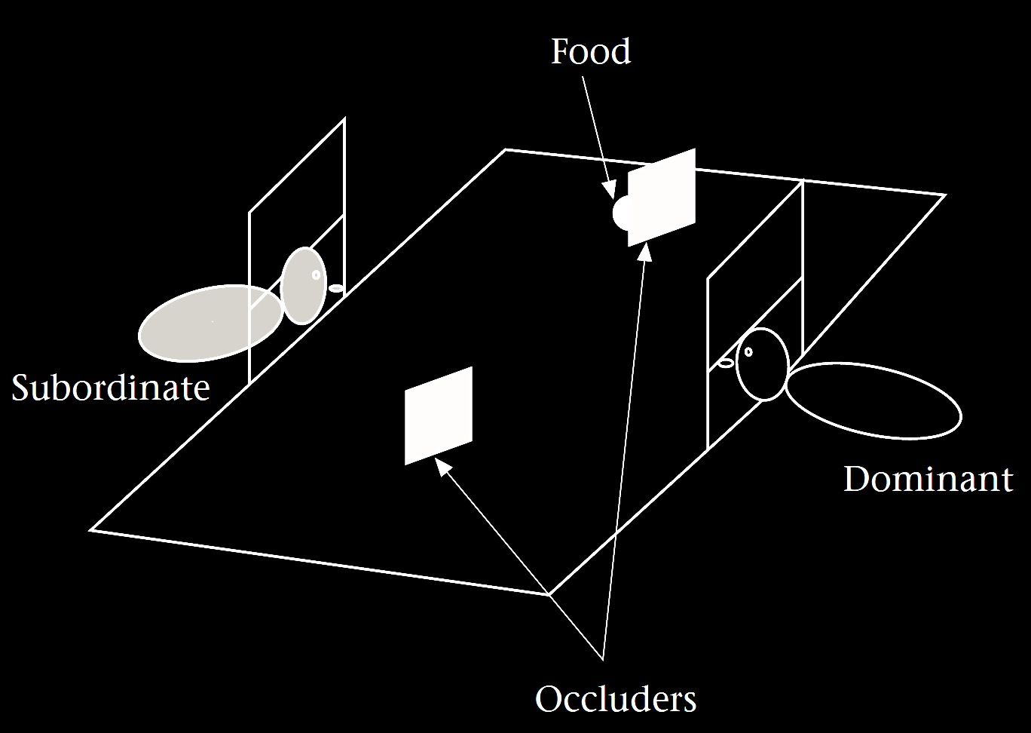
Your field = a set of objects related to you by proximity, orientation, lighting and other factors
You encounter an object = it is in your field
You register an object at a location = you most recently encountered the object at that location
Principle 3: one can’t goal-directedly act on an object unless one has encountered it.
Principle 2: correct registration is a condition of successful action.
Principle 3: when an agent performs a goal-directed action and the goal specifies an object, the agent will act as if the object were actually in the location she registers it at.
proximity
orientation
lighting
barriers
trajectory
Notes:
In this experiment by Brian Hare and colleagues, a subordinate chimpanzee makes predictions about a dominant chimpanzee’s ability to retrieve food. They found that the subordinate’s predictions take into account whether the dominant’s view was blocked while the food was placed. This could be explained by the Third Principle. For the subordinate to predict that the dominant will not be able to recover the food, it is sufficient to think: because the dominant did not encounter the food, she will not be able to retrieve it.

Slide 68
Your field = a set of objects related to you by proximity, orientation, lighting and other factors
You encounter an object = it is in your field
You register an object at a location = you most recently encountered the object at that location
Principle 1: one can’t goal-directedly act on an object unless one has encountered it.
Principle 2: correct registration is a condition of successful action.
Principle 3: when an agent performs a goal-directed action and the goal specifies an object, the agent will act as if the object were actually in the location she registers it at.
proximity
orientation
lighting
barriers
trajectory

Slide 69
Your field = a set of objects related to you by proximity, orientation, lighting and other factors
You encounter an object = it is in your field
You register an object at a location = you most recently encountered the object at that location
Principle 1: one can’t goal-directedly act on an object unless one has encountered it.
Principle 2: correct registration is a condition of successful action.
Principle 3: when an agent performs a goal-directed action and the goal specifies an object, the agent will act as if the object were actually in the location she registers it at.
proximity
orientation
lighting
barriers
trajectory
Notes:
For the next principles we need the notion of registration. This is a relation between agents, objects and locations. An agent registers an object at a location just if she last encountered it there. Registrations can be correct or incorrect. A registration is incorrect when an agent registers an object at a location but it is not at that location.

Slide 70
Your field = a set of objects related to you by proximity, orientation, lighting and other factors
You encounter an object = it is in your field
You register an object at a location = you most recently encountered the object at that location
Principle 1: one can’t goal-directedly act on an object unless one has encountered it.
Principle 2: correct registration is a condition of successful action.
Principle 3: when an agent performs a goal-directed action and the goal specifies an object, the agent will act as if the object were actually in the location she registers it at.
proximity
orientation
lighting
barriers
trajectory
Notes:
Principle Four says that correct registration is a condition of successful action. If you have a goal involving an object, you will only succeed if you register the object at its actual location. To illustrate, suppose you see someone encountering an object which is then moved while they are not watching it. In this situation, Principle Four allows you to predict that they will not be successful in retrieving that object.

Slide 71
Your field = a set of objects related to you by proximity, orientation, lighting and other factors
You encounter an object = it is in your field
You register an object at a location <= you most recently encountered the object at that location
Principle 3: one can’t goal-directedly act on an object unless one has encountered it.
Principle 4: correct registration is a condition of successful action.
Principle 3: when an agent performs a goal-directed action and the goal specifies an object, the agent will act as if the object were actually in the location she registers it at.
proximity
orientation
lighting
barriers
trajectory

Slide 72
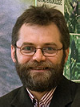
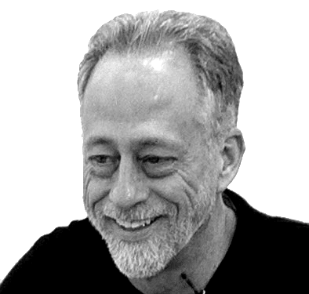
“chimpanzees understand … intentions … perception and knowledge … Moreover, they understand how these psychological states work together to produce intentional action”
(Call & Tomasello 2008:191)

Slide 73
“chimpanzees understand … intentions … perception and knowledge … Moreover, they understand how these psychological states work together to produce intentional action”
(Call & Tomasello 2008:191)
“chimpanzees probably do not understand others in terms of a fully human-like belief–desire psychology”
(Call and Tomasello 2008)

Slide 74
“chimpanzees understand … intentions … perception and knowledge … Moreover, they understand how these psychological states work together to produce intentional action”
(Call & Tomasello 2008:191)
“chimpanzees probably do not understand others in terms of a fully human-like belief–desire psychology”
(Call and Tomasello 2008)

Slide 75
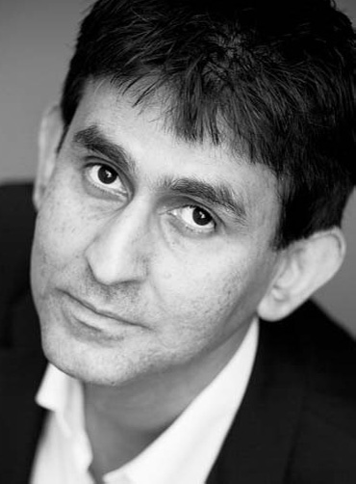
“chimpanzees understand … intentions … perception and knowledge … Moreover, they understand how these psychological states work together to produce intentional action”
(Call & Tomasello 2008:191)
“our [typical adult humans’] fundamental conception of what it is to know that P is itself an explanatory conception […] we think of S’s knowledge that P as something that can properly be explained by reference to what S has perceived or remembered or proved or ...”
(Cassam 2007: 356)

Slide 76
Your field = a set of objects related to you by proximity, orientation, lighting and other factors
You encounter an object = it is in your field
You register an object at a location = you most recently encountered the object at that location
Principle 1: one can’t goal-directedly act on an object unless one has encountered it.
Principle 2: correct registration is a condition of successful action.
Principle 3: when an agent performs a goal-directed action and the goal specifies an object, the agent will act as if the object were actually in the location she registers it at.
proximity
orientation
lighting
barriers
trajectory

Slide 77
source: Liszkowski et al (2008)

Slide 78
source: Liszkowski et al (2008)

Slide 79
source: Liszkowski et al (2008)

Slide 80
source: Liszkowski et al (2008)

Slide 81
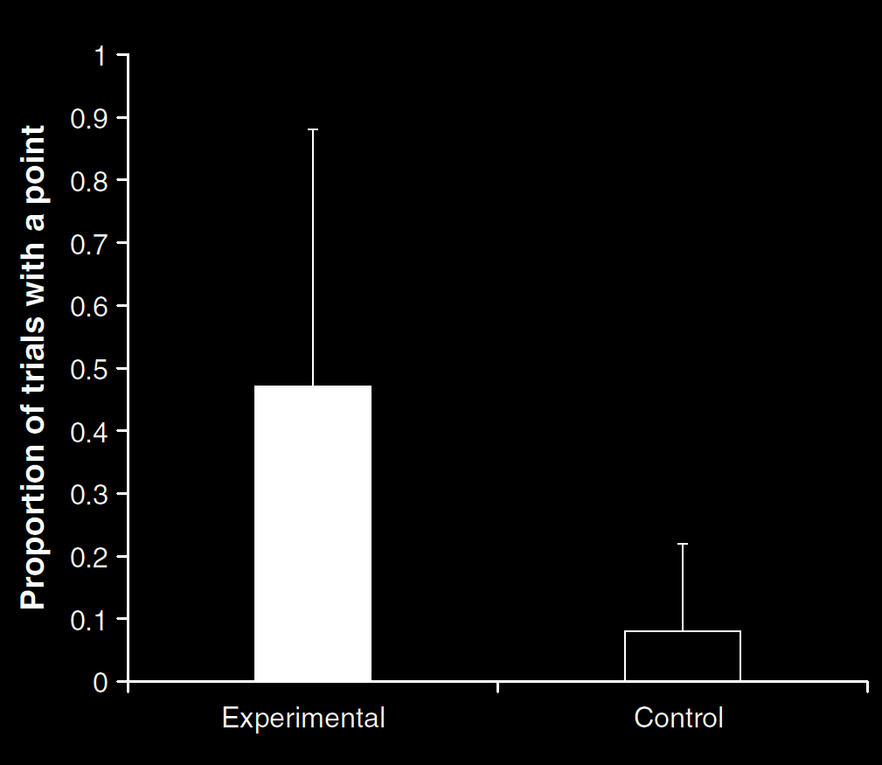
Your field = a set of objects related to you by proximity, orientation, lighting and other factors
You encounter an object = it is in your field
You register an object at a location = you most recently encountered the object at that location
Principle 1: one can’t goal-directedly act on an object unless one has encountered it.
Principle 2: correct registration is a condition of successful action.
Principle 3: when an agent performs a goal-directed action and the goal specifies an object, the agent will act as if the object were actually in the location she registers it at.
source: Liszkowski et al (2008)
proximity
orientation
lighting
barriers
trajectory

Slide 82
Your field = a set of objects related to you by proximity, orientation, lighting and other factors
You encounter an object = it is in your field
You register an object at a location = you most recently encountered the object at that location
Principle 1: one can’t goal-directedly act on an object unless one has encountered it.
Principle 2: correct registration is a condition of successful action.
Principle 3: when an agent performs a goal-directed action and the goal specifies an object, the agent will act as if the object were actually in the location she registers it at.
“Helping by informing inextricably involves … an understanding of others’ goals and … of others’ ignorance.”
(Liszkowski, Carpenter & Tomasello 2008: 738-9)
source: Liszkowski et al (2008)
proximity
orientation
lighting
barriers
trajectory

Slide 83
Your field = a set of objects related to you by proximity, orientation, lighting and other factors
You encounter an object = it is in your field
You register an object at a location = you most recently encountered the object at that location
Principle 1: one can’t goal-directedly act on an object unless one has encountered it.
Principle 2: correct registration is a condition of successful action.
Principle 3: when an agent performs a goal-directed action and the goal specifies an object, the agent will act as if the object were actually in the location she registers it at.
“Helping by informing inextricably involves … an understanding of others’ goals and … of others’ ignorance.”
(Liszkowski, Carpenter & Tomasello 2008: 738-9)
“Helping by informing inextricably involves … an understanding of others’ goals and … of others’ ignorance.”
(Liszkowski, Carpenter & Tomasello 2008: 738-9)
source: Liszkowski et al (2008)
proximity
orientation
lighting
barriers
trajectory

Slide 84
Your field = a set of objects related to you by proximity, orientation, lighting and other factors
You encounter an object = it is in your field
You register an object at a location = you most recently encountered the object at that location
Principle 1: one can’t goal-directedly act on an object unless one has encountered it.
Principle 2: correct registration is a condition of successful action.
Principle 3: when an agent performs a goal-directed action and the goal specifies an object, the agent will act as if the object were actually in the location she registers it at.
proximity
orientation
lighting
barriers
trajectory

Slide 85
Your field = a set of objects related to you by proximity, orientation, lighting and other factors
You encounter an object = it is in your field
You register an object at a location = you most recently encountered the object at that location
Principle 1: one can’t goal-directedly act on an object unless one has encountered it.
Principle 2: correct registration is a condition of successful action.
Principle 3
proximity
orientation
lighting
barriers
trajectory

Slide 86
Your field = a set of objects related to you by proximity, orientation, lighting and other factors
You encounter an object = it is in your field
You register an object at a location = you most recently encountered the object at that location
Principle 1: one can’t goal-directedly act on an object unless one has encountered it.
Principle 2: correct registration is a condition of successful action.
Principle 3: when an agent performs a goal-directed action and the goal specifies an object, the agent will act as if the object were actually in the location she registers it at.
proximity
orientation
lighting
barriers
trajectory
Notes:
Principle Four doesn’t enable you to pass false belief tasks. This is because when people have incorrect registrations, this Principle doesn’t allow you to predict what actions they will perform. To do this you need Principle Five. With this Principle, we move from thinking of registration as a condition on action to thinking of it as a cause of action. Principle Five says that agents will act as if objects were actually at the locations they register them as being. What determines where an agent will look for an object is not its actual location but the location the agent registered it as being at. This Principle is sufficient for passing some false belief tasks.
These five Principles can be extended to explain further theory of mind abilities. I only cover these five in the poster because they are the minimum needed for passing some famous infant false belief tasks.

Slide 87
signature limits

Slide 88
1. There are subjects who can pass A-tasks but cannot pass B-tasks.
2. These subjects’ success on A-tasks is explained by the fact that they can represent (false) beliefs
3. These subjects’ failure on B-tasks is explained by the fact that they cannot represent (false) beliefs
using a simple measure
in a modular process
using a sophisticated measure
in a non-modular process
Notes:
We must be able to tell empirically

Slide 89
signature limits

Slide 90
1. Charly is Samantha
2. Mitch believes that Charly is in Baltimore
3. Mitch believes that Samantha is in Baltimore
(1) & (2) ⇒ (3)

Slide 91
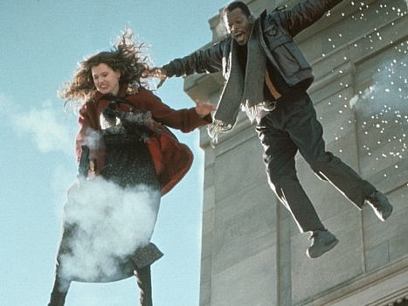
1. Charly is Samantha
2. Mitch believes that Charly is in Baltimore
3. Mitch believes that Samantha is in Baltimore
(1) & (2) ⇒ (3)

Slide 92
1. Charly is Samantha
2. Mitch believes that Charly is in Baltimore
3. Mitch believes that Samantha is in Baltimore
(1) & (2) ⇒ (3)
4. Mitch registers <Charly, Baltimore>
5. Mitch registers <Samantha, Baltimore>
(1) & (4) ⇒ (5)

Slide 93
False belief about location
False belief about identity
Subjects represent registration
Subjects represent beliefs
pass
fail
pass
pass

Slide 94
Rubio, Richardson & Butterfill
Notes:
First introduce them to a sequence in three slides ... [large pictures so hopefully everyone can see what’s going on]
These are all from the subject’s point of view.
We’re going to start with what looks almost exactly like the test condition from a standard false belief task.
(1) The observer watches as his car disappears behind a barrier on your [audience’s] left

Slide 95
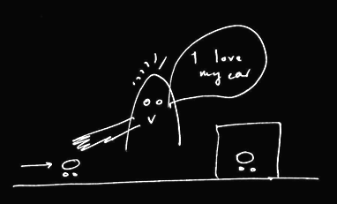
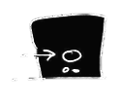
Rubio, Richardson & Butterfill
Notes:
First introduce them to a sequence in three slides ... [large pictures so hopefully everyone can see what’s going on]
These are all from the subject’s point of view.
We’re going to start with what looks almost exactly like the test condition from a standard false belief task.
(1) The observer watches as his car disappears behind a barrier on your [audience’s] left

Slide 96
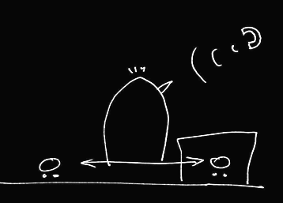

Rubio, Richardson & Butterfill
Notes:
(2) a telephone rings and the observer is distracted ... meanwhile the cars silently swap places (they’re electric cars, natch).

Slide 97
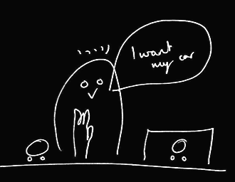
Rubio, Richardson & Butterfill
Notes:
(3) the observer comes back and wants to get her car (note the raised hand). Where do subjects look? They know that the observer’s car is actually behind the barrier. They are also in a position to know that the observer might not know this and might mistakenly think that his car is the one on subject’s LEFT.

Slide 98
her car is here
Rubio, Richardson & Butterfill
Notes:
(3) the observer comes back and wants to get her car (note the raised hand). Where do subjects look? They know that the observer’s car is actually behind the barrier. They are also in a position to know that the observer might not know this and might mistakenly think that his car is the one on subject’s LEFT.

Slide 99
she believes her car is here
her car is here
Rubio, Richardson & Butterfill
Notes:
(3) the observer comes back and wants to get her car (note the raised hand). Where do subjects look? They know that the observer’s car is actually behind the barrier. They are also in a position to know that the observer might not know this and might mistakenly think that his car is the one on subject’s LEFT.

Slide 100
she believes her car is here
her car is here
Rubio, Richardson & Butterfill
Notes:
(3) the observer comes back and wants to get her car (note the raised hand). Where do subjects look? They know that the observer’s car is actually behind the barrier. They are also in a position to know that the observer might not know this and might mistakenly think that his car is the one on subject’s LEFT.

Slide 101
we predict Ss will look here
she believes her car is here
her car is here
Rubio, Richardson & Butterfill
Notes:
(3) the observer comes back and wants to get her car (note the raised hand). Where do subjects look? They know that the observer’s car is actually behind the barrier. They are also in a position to know that the observer might not know this and might mistakenly think that his car is the one on subject’s LEFT.

Slide 102
Rubio, Richardson & Butterfill
Notes:
Here’s the whole sequence again, smaller.
If we were doing a standard false belief test, we could compare where people look in this sequence with where they look in another sequence in which the observer doesn’t turn away in the second scene.
If subjects can track false beliefs, we would expect them to be more likely to look towards SUBEJECTS-LEFT location in the depicted narrative than in the control version where the subject is not distracted by the telephone and so does not look away.
So this is almost a standard false belief task.
And like all standard false belief tasks, it requires tracking false beliefs about location only; it doesn’t require tracking false beliefs about registration.
Now consider a tiny variation ...

Slide 103
Rubio, Richardson & Butterfill
Notes:
... the middle vertical sequence is just like the right vertical sequence except that one of the barriers has been removed.
Now there are two ways of thinking about this.
On one way of thinking about it, there is no reason to think that the observer has a false belief because in the final scene (of the middle sequence) he’s looking right at a car which is not his own.
But if you think about this more carefully, that isn’t quite right because the car he’s looking at, although not his own, is visually indistinguishable from his own. So he might well believe, falsely, that his car on SUBJECTS-LEFT is actually his car.
So where subjects are capable of tracking false beliefs involving identity & where they realize that the cars are visually indistinguishable, they should be able to predict an incorrect reach.
But if subjects are not tracking about false beliefs about identity, then they will think that the observer will be able to retrieve his car from its actual location.

Slide 104
2
3
Rubio, Richardson & Butterfill
Notes:
... so let’s illustrate this with some graphs ...

Slide 105
2
3
belief: 2 ≈ 3
Rubio, Richardson & Butterfill
Notes:
... so let’s illustrate this with some graphs ...

Slide 106
2
3
belief: 2 ≈ 3
Rubio, Richardson & Butterfill
Notes:
... so let’s illustrate this with some graphs ...

Slide 107
2
3
left
right
left
right
belief: 2 ≈ 3
2
3
Rubio, Richardson & Butterfill
Notes:
... so let’s illustrate this with some graphs ...

Slide 108
2
3
left
right
left
right
belief: 2 ≈ 3
2
3
registration: 2 ≈ 3
Rubio, Richardson & Butterfill
Notes:
... so let’s illustrate this with some graphs ...

Slide 109
2
3
left
right
left
right
belief: 2 ≈ 3
2
3
registration: 2 ≈ 3
Rubio, Richardson & Butterfill
Notes:
... so let’s illustrate this with some graphs ...

Slide 110
2
3
left
right
left
right
belief: 2 ≈ 3
2
3
registration: 2 ≈ 3
left
right
left
right
2
3
Rubio, Richardson & Butterfill
Notes:
... so let’s illustrate this with some graphs ...

Slide 111
2
3
left
right
left
right
belief: 2 ≈ 3
2
3
registration: 2 ≈ 3
left
right
left
right
2
3
Rubio, Richardson & Butterfill
Notes:
... so let’s illustrate this with some graphs ...

Slide 112
Rubio, Richardson & Butterfill
Notes:
now consider a third variation ...

Slide 113

Rubio, Richardson & Butterfill
Notes:
The new sequence is the one on your [the audience’s] left.
Here the two cars are visibly distinguishable.
To us it probably seems obvious that, in the left vertical sequence, the observer will reach behind the barrier. Whereas this is not nearly so obvious in the middle vertical sequence. But now consider someone incapable of reasoning about false beliefs involving identity. From her point of view, the two sequences are not different. To her what matters is just that numerically distinct objects appear on the left. So (assuming she doesn’t lose track of the objects) she has no more reason to think that the observer will reach behind the barrier in the middle sequence than she does in the left sequence.

Slide 114
1
2
3
Rubio, Richardson & Butterfill
Notes:
... lets illustrate this with some graphs

Slide 115
1
2
3
belief: 2 ≈ 3
registration: 2 ≈ 3
belief: 1 ≈ 2
registration: 1 ≈ 2
Rubio, Richardson & Butterfill
Notes:
... lets illustrate this with some graphs

Slide 116
False belief about location
False belief about identity
Subjects represent registration
Subjects represent beliefs
pass
fail
pass
pass
Notes:
A second illustration --- skip this

Slide 117
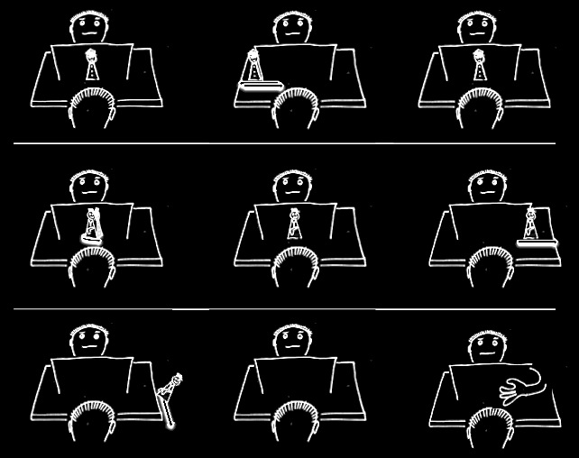

Slide 121
Notes:
Although this is my view and I stand by it, I don't think it resolves the puzzle all by itself.
The problem is this.
Success on many B-tasks is in principle possible using only a very simple measure for representing beliefs.
Further, B-tasks do not seem to differ from A-tasks with respect to which measures for representing beliefs could in principle explain success on these tasks.
So the view raises and does not answer the question of why children continue to systematically fail false belief B-tasks years after they can pass A-tasks.

Slide 122
1. There are subjects who can pass A-tasks but cannot pass B-tasks.
2. These subjects’ success on A-tasks is explained by the fact that they can represent (false) beliefs
3. These subjects’ failure on B-tasks is explained by the fact that they cannot represent (false) beliefs
using a simple measure
in a modular process
using a sophisticated measure
in a non-modular process
Notes:
to make sense of modular mindreading you need relatively simple measures of belief; and these relatively simple measures need to be constructed; in describing minimal theory of mind we have described a measure of belief which is flexible enough to explain success on a variety of false belief tasks but which could also be implemented efficiently, without placing demands on executive function, working memory and attention. Minimal theory of mind may be what enables those with limited cognitive resources or little cognitive sophistication ... to track others’ beliefs.

